Slide 1

Period End Closing Key Process Areas and New Period End Checks
Currency Revaluation
G/L Closing Activities for Financial Statement Preparation
AP/AR Regrouping
Currency Translation
Functional Area Adjustment

Slide 2
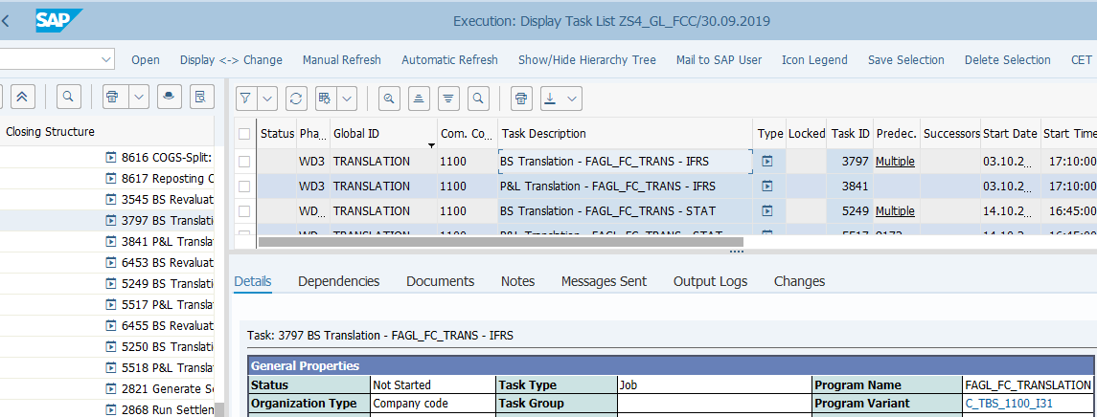
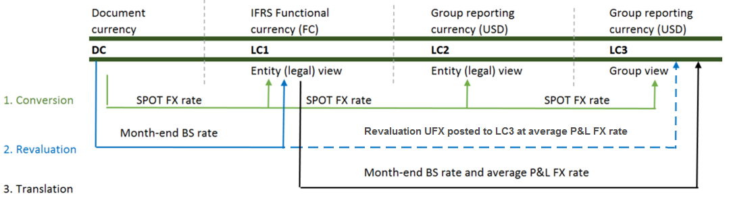
Currency Translation Process Overview
Basic Process of Translation
Balance Sheet Translation is the process at period end for all B/S account balances in LC1 to be translated from LC1 to group currency LC3 at balance sheet date rate (JT Rate), and P&L accounts at RM (monthly average) Rate.
In S/4HANA the Core Principles on FX Rate sources, FX Rate trigger dates and Translation calculations remain unchanged.
At period end all G/L balances which have balances in LC1 (except equity accounts) are translated to LC3 in IFRS ledger and to LC2 in STAT and TAX ledgers @JT Rate for B/S items and @RM rate for P&L items.
Translation posts CTA (B/S to B/S in B/S Translation and B/S to P&L in P&L Translation) in LC3/LC2.
Translation is performed separately for different ledgers as per closing calendar. To meet the different translation calculation requirements in different ledgers, Valuation Areas¹⁾ are used.
The variants used in Translation transaction are unique to each entity but they all use variables for dates/periods/years fields. You should always check/amend the values of these fields to ensure they are correct before executing Translation outside of FCC.
¹⁾ Details on Valuation Areas and Translation Calculation Methods are available in Parallel Ledger training course.
T-Code: FAGL_FC_TRANS
There should be more than one B/S and P&L Translation tasks per entity as these are executed for each ledger using the corresponding Valuation Areas, which determine the valuation calculation methods, the rates and how postings should be made.
In S/4 HANA, the transaction will post the documents simultaneously with only erroneous entries sent to a Batch Input session for user to process.
FCC Task: Entity Level
The Translation tasks are set at entity level.
Timing: WD3 – IFRS
WD10 – STAT/TAX ²⁾
Translation are to be performed as one of the final financial statements preparation tasks, after Revaluation and AP/AR Regrouping, which will be WD3 for IFRS and WD10 for STAT/TAX.
²⁾ There are approved exceptions for entities (Turkey and Russia) to run Translation for STAT/TAX on WD14.

Slide 3
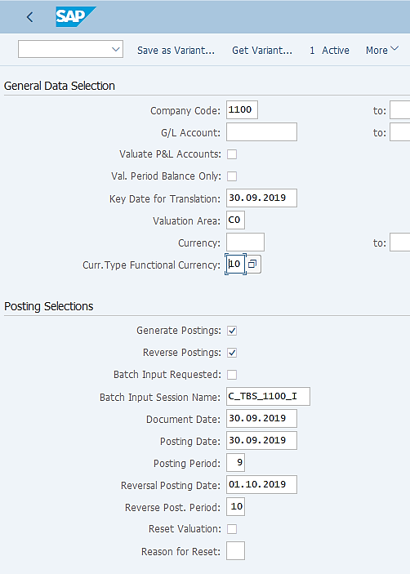
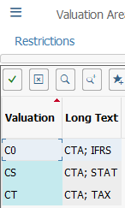
Currency Translation: Execution (1/2)
FAGL_FC_TRANS: Translation
Transaction FAGL_FC_TRANS is new in S/4 HANA, and this is a different transaction from Revaluation. Make sure you use the same Variant as stated in the FCC task if you execute this transaction outside of FCC.
Translation is executed for one entity at a time in JTI (although the system does allow you to input more than one company codes). Variants for each Translation requirements of each entity has been created. If you have a new requirement you should liaise with the entity and BTS to have the new variant created and updated in FCC.
Valuation P&L Accounts and Val. Period Balance Only checkboxes are ticked in P&L Translation variants.
Key Date for Translation is the last date of the month that is being closed.
Value Area determines how the revaluation/translation is to be calculated. We use different Valuation Areas for different Accounting Principles (E.g. IFRS, STAT, Tax). For Translation, the following Valuation Areas are used: C0-for IFRS, CS-for STAT and CT-for Tax.
This is the base currency for Translation. In our case it will be currency type 10 – LC1.
Generate Postings will trigger the Translation postings. If you do it outside of FCC, you may first execute the transaction without ticking Generate Postings, which effectively will give you a Test Run result.
Reverse Postings should be selected for B/S translations as these should be reversed at the beginning of the following period. P&L Translation is not reversed.
The Batch Input session name corresponds to the Translation variant names. It is needed when documents can’t be posted simultaneously when the transaction is run. This example means it is for Balance Sheet Translation (TBS), entity 1100 and for IFRS ledger (I).
Translation is to be posted on the last date of a month that is being closed and reversed (only B/S Translation) on the first date of the following month.
These fields need to be populated in case you wish to reset a previous Translation run, for example when a Translation run was done incorrectly. You should populate other fields based on the actual Translation run you wish to reverse, otherwise you may be reversing a wrong Translation Run.
This will reverse the Translation postings, which is why you need to provide a Reason for Reset. Make sure you consult your GL Team Lead or the person in charge of closing before resetting any Translation.

Slide 4
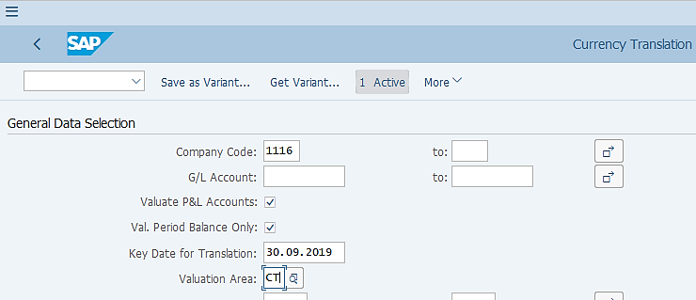
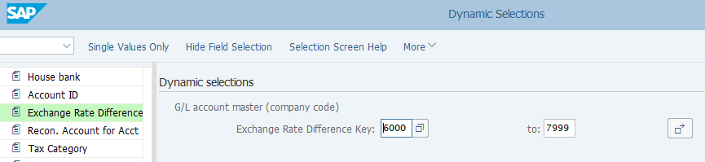
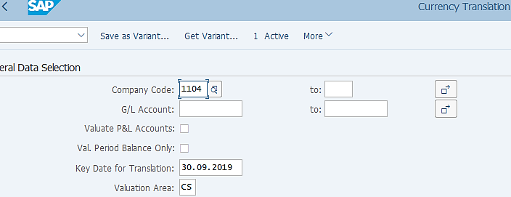
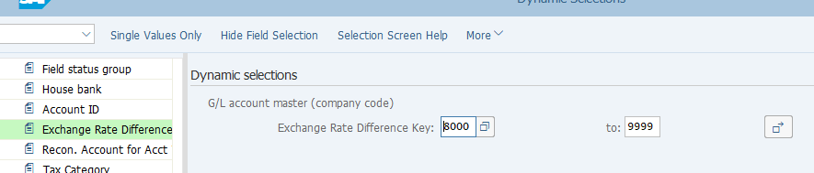
Currency Translation: Execution (2/2)
FAGL_FC_TRANS: Translation – P&L Trans Variant
You may have noticed that our Translation variants do not have restrictions/selection of G/L accounts. However G/L accounts are indeed restricted, which is done via the “Dynamic Selection” shown below.
Exchange Rate Different Key (ERDK) ¹⁾
P&L Accounts subject to Translation are assigned with ERDK range 6000-7999
Balance Sheet accounts subject to Translation are assigned with ERDK range 8000-9999.
FAGL_FC_TRANS: Translation – B/S Trans Variant
¹⁾ Refer to Chart of Accounts course materials for details on ERDK.

Slide 5
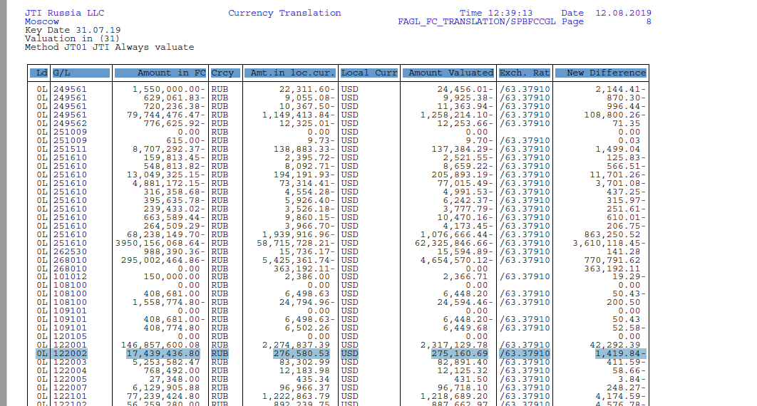


Currency Translation: Output (1/2)
If you execute Translation via or outside of FCC, you will see an output looks like the below. The illustration below explains how the Translation is calculated using an example for IFRS Translation, i.e. target currency is LC3.
FAGL_FC_TRANS: Translation – Output Log
What has changed in S/4HANA?
Only LC1 balances at G/L account level are taken into account for calculation, i.e.
Open Items are not listed in the log
LC1 and LC2/LC3 amounts at Open Item level are not used for calculation
Each G/L account which have LC1 balances are listed based on balances in different Profit Centers, based on which the LC1@JT Rate for B/S items and LC1@RM Rate for P&L items are calculated.
Unlike in ECC, the Translation process looks at the original LC1 and LC3 balances, instead of the LC1/LC3 amounts which were updated during the Revaluation process (UFX). As a result:
The FX Adjustment accounts, which receives postings from Revaluation runs, must be included in Translation run selection.
Translation is executed after AR/AP Regrouping process, as AR/AP Regrouping also doesn’t take into account the valuation differences (UFX or CTA) in LC3 posted via Revaluation and Translation.
Translated LC1 in USD =
17,439,436.80/63.37910 = 275,160.69
CTA= 275,160.69-276,580.53 = -1,419.84
LC1 Balance
LC3 Balance
Calculated LC1@JT Rate
JT Rate
CTA
ZFCMA13 – Display FX Rate

Slide 6
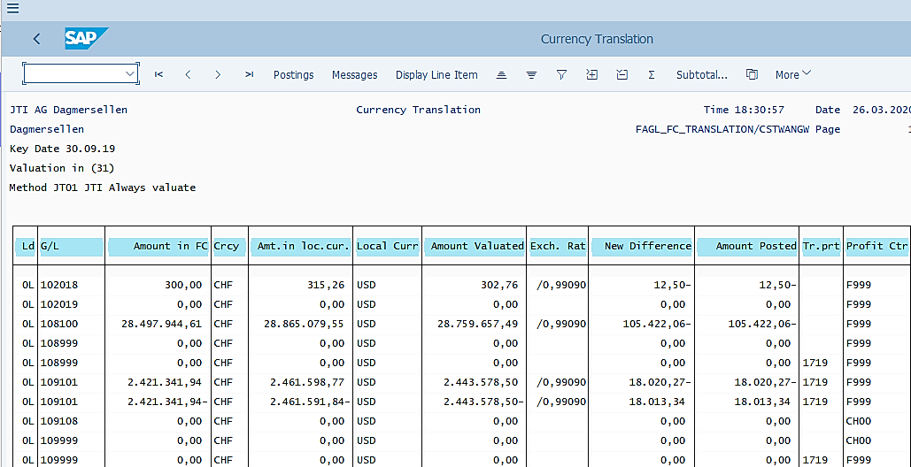
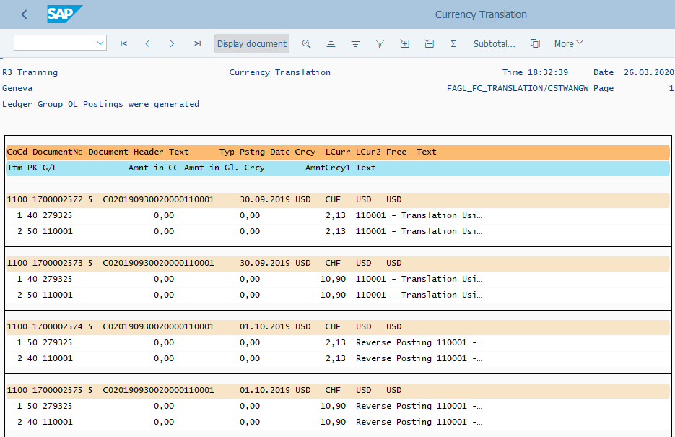
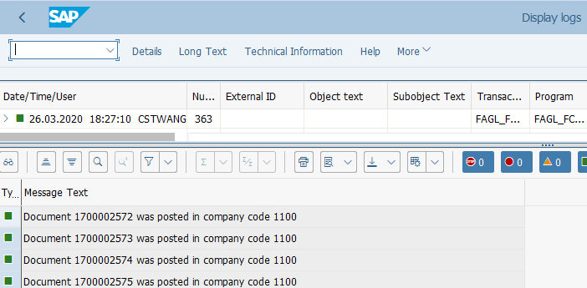
Currency Translation: Output (2/2)
FAGL_FC_TRANS: Translation – Output Log
You should review and save the output log of FAGL_FC_TRANS if you execute it outside of FCC.
Postings log allows you to see the document posted (Translation and Reversal), which even allows you to Display the document directly from this screen if needed.
Messages are important especially when there are errors. You should Test Run (untick Generate Posting) this transaction to prevent critical errors during update run.

Slide 7
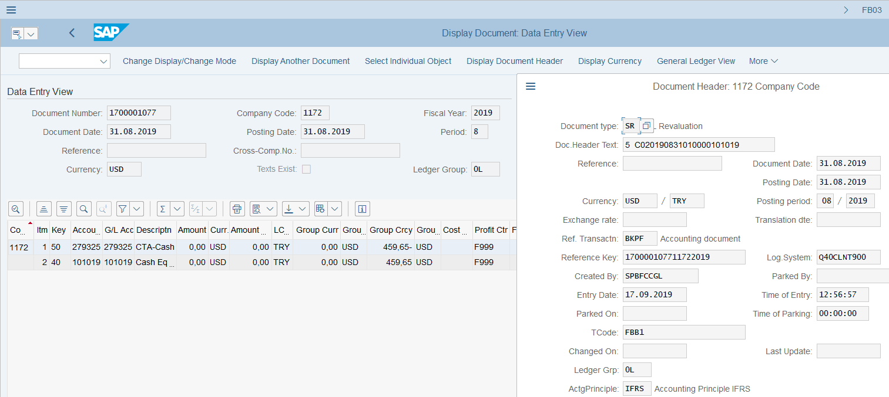
Currency Translation Posting Example – Balance Sheet (B/S) Accounts
B/S Translation posting uses Doc. Type SR, same as in ECC.
B/S Translation task is built in FCC, which is automatically triggered. Entities can display the job log and spool list in FCC.
Accounting entries on B/S Translation documents are between the original account or FX adjustment accounts (for OIM, LSC and AR/AP Reconciliation accounts) and CTA accounts. Refer to Currency Conversion section of Parallel Ledger course for how the values are calculated.
B/S Translation is executed for each accounting principle separately using different valuation areas (explained in Parallel Ledger course). Postings are made to the corresponding ledger only.

Slide 8
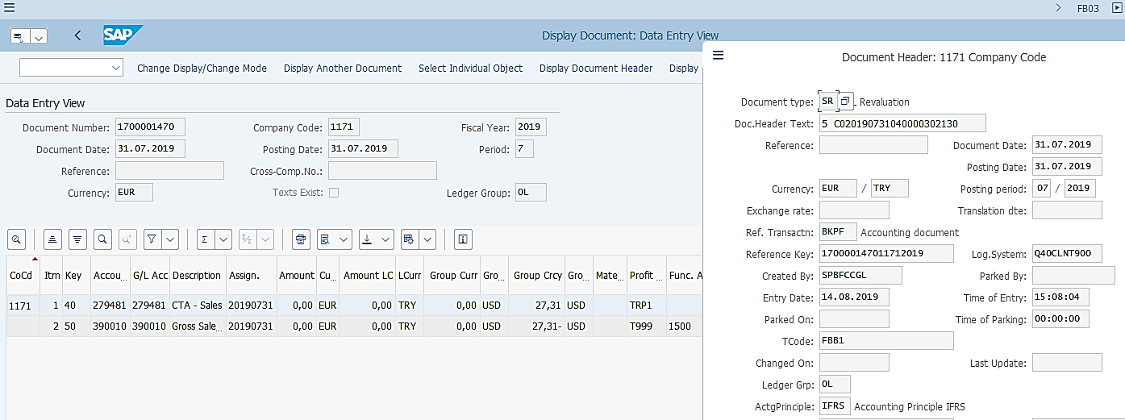
P&L Translation Posting Example
P&L Translation is also posted with Doc. Type SR, same as in ECC.
P&L Translation task is built in FCC, which is automatically triggered. Entities can display the job log and spool list in FCC.
Accounting entries P&L Translation documents are between the CTA accounts (279xxx) and the P&L accounts defined as per ERDK for use in P&L translation posting. Refer to Finance Fundamentals Master Data – Chart of Accounts course for ERDK in P&L accounts.
P&L Translation is executed for each accounting principle separately using different valuation areas (explained in Parallel Ledger course). Postings are made to the corresponding ledger only.

Slide 9

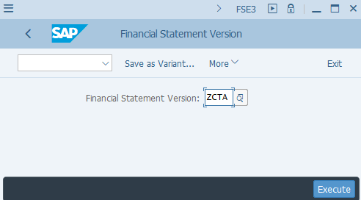
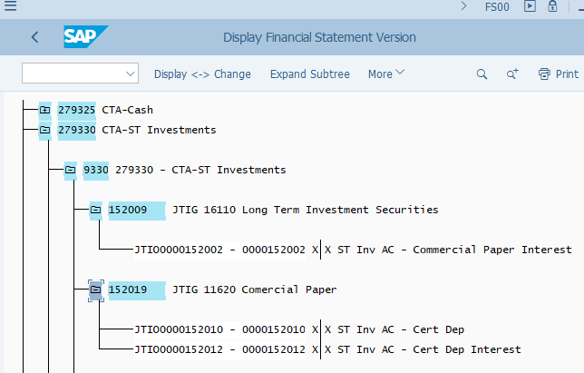
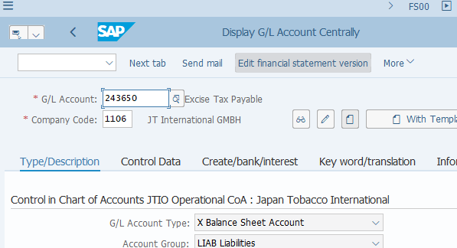
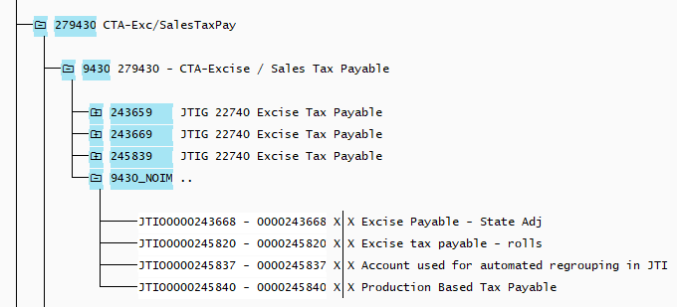
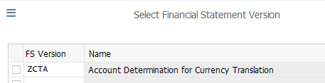
Currency Translation: FX Adjustment Accounts
In S/4 the FX Adjustment Accounts and CTA accounts used in Currency Translation postings are defined based on Financial Statement Versions (FSV). FSV “ZCTA” is created for this purpose. You can find the relevant FX Adjustment and CTA accounts for a given G/L accounts by following the steps below. ¹⁾
FSE3: Display FSV
FSV ZCTA is organized by CTA accounts as the highest hierarchy node.
The node under CTA folders are ERDK(Exchange Rate Different Key) folders
G/L accounts under this folder are folders for each of the FX Adjustment accounts (ending with 9) which is used to post against CTA during Translation.
You may also display FSV via G/L Account Display T-Code FS00. Then click “Edit financial statement version”
Under the folders of each FX Adjustment account, are the “original” G/L accounts which have their CTA amount posted against the corresponding FX Adjustment account. E.g. in this example, G/L 152002 has ERDK 9330 assigned to its G/L master and the translation posting for this account is posted to 152009 against CTA 279330.
You may enter ZCTA here or select it from the dropdown list. Then click “Choose”.²⁾
There’s also a folder like this “…_NOIM”. These folders group the flat accounts which would post translation results to themselves against the corresponding CTA accounts as per ERDK.
¹⁾ This is not a routine activity for end users. GBS/JTBC G/L users may want to perform this check during testing (e.g. test a newly created G/L account) or investigate any posting errors during period end Currency Translation. R2R CC should be contacted for any queries.
²⁾ End users do not have access to “Edit” FSV therefore this action will take you to the display of FSV ZCTA as shown in this example.

Slide 10
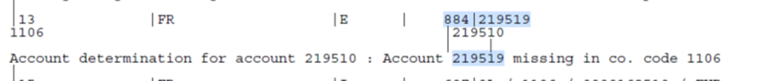
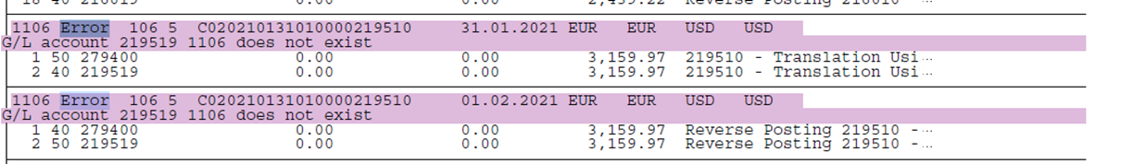
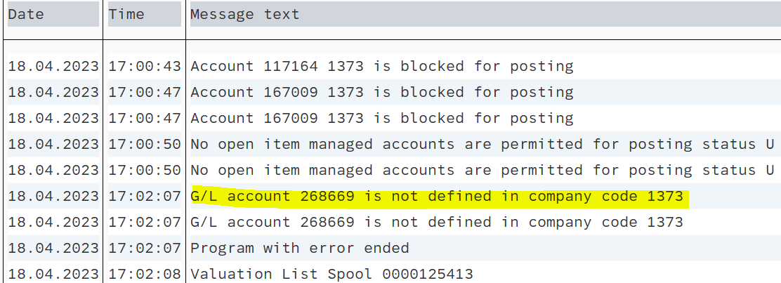
Currency Translation - Common Errors
Detail of the “Errors” can be checked from the “Output Logs”. GL Team needs to check the error and work as per the resolution mentioned below.
Errors | Error Description (Reason) | Resolution
Account determination for account XXX: Account XXX missing in company code G/L account XXX is not defined in company code. G/L account does not exist in company code | These error occurs when G/L Account does not exist in Company Code | GL Team to ask Market to create required account. If amount is immaterial, it is ok to change status to “checked” in FCC, if material it might be a subject to HQ

Slide 11
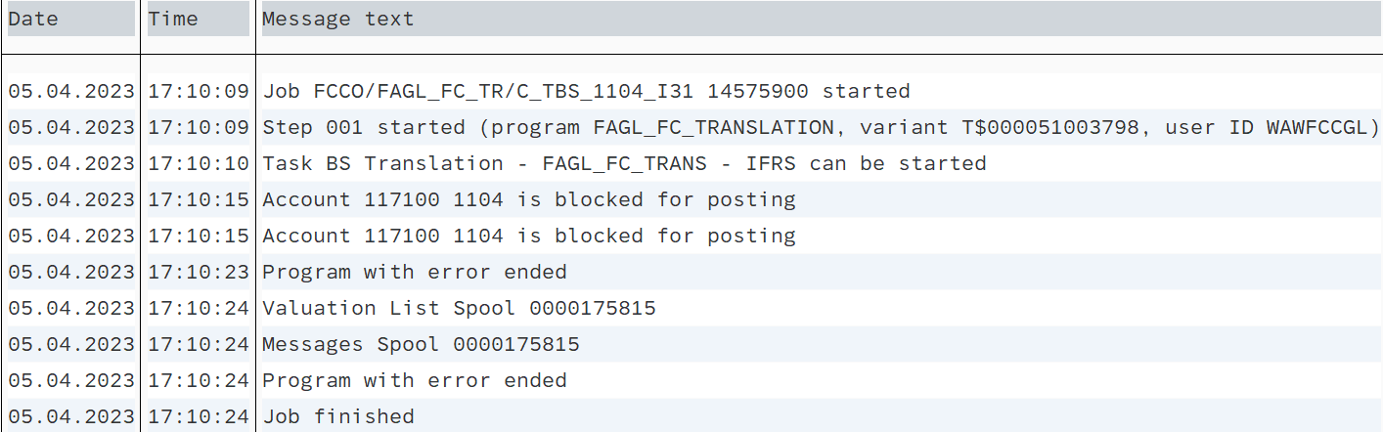
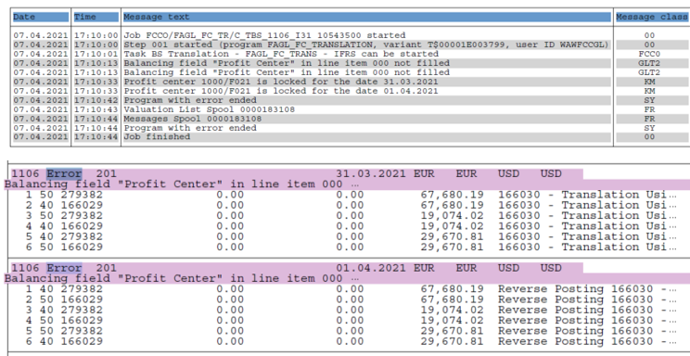
Currency Translation - Common Errors
Errors | Error Description (Reason) | Resolution
Account XXX is blocked for posting | This error occurs when Account is not in use in Company Code and block for posting. | GL Team needs to check the balance on the account: If there is a balance and amount is not material, GL Team contacts Market to unblock account aтd clean-up the balance for next period. If amount is material, GL Team needs to ask Market to unblock account for the same period. Once account is unblocked GL Team can run the translation for this particular account manually. If Market is not be able to unblock account quickly then HQ journal will be required. If account balance is zero GL Team needs to check whether posting on blocked account is zeroed out on Profit Center and/or Trading partner level. If not, GL Team needs contact market to perform necessary corrections, otherwise the system will be picking up these items for revaluation even though on the account level the balance is zero.
Balancing field "Profit Center" not filled. | This error occur when initial posting is without Profit Center. | From S/4HANA perspective, such items are not subject for translation. Moreover, such documents should not exist in the system at all. GL Team needs to skip such error message during SM35 processing and discuss with Market how to correct wrongly posted documents. Workaround - Enter a Profit Center number to clear the items

Slide 12
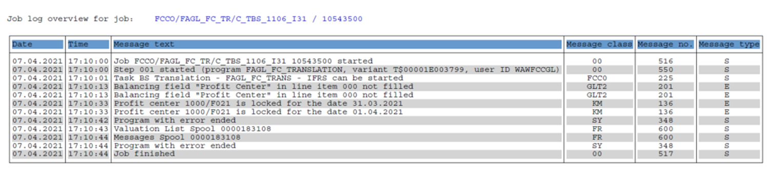
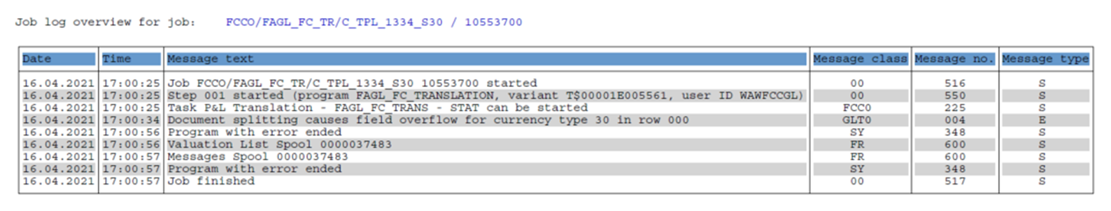
Currency Translation - Common Errors
Errors | Error Description (Reason) | Resolution
Profit Center is locked for the date | This error occurs when Profit Center is blocked for posting. | GL Team to Inform Market about the error, and if Profit Center is wrongly locked, Market should extend the related validity to current period.
Document splitting causes field overflow for currency type 30 |  | GL Team to check the financial impact, if amount is material GL Team should inform Market Team and raise ticket with IT.

Slide 13
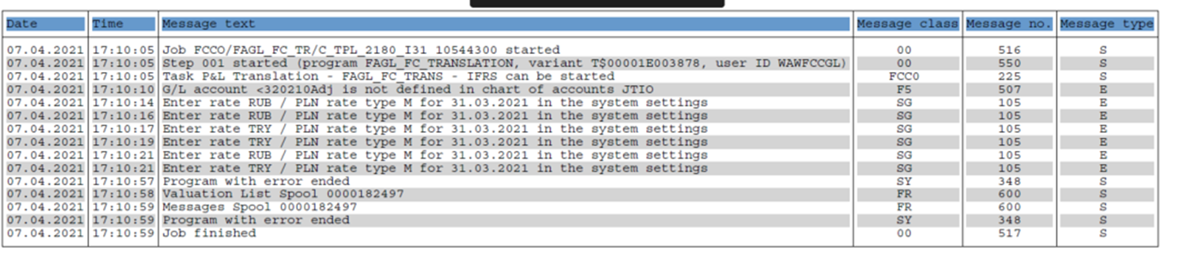
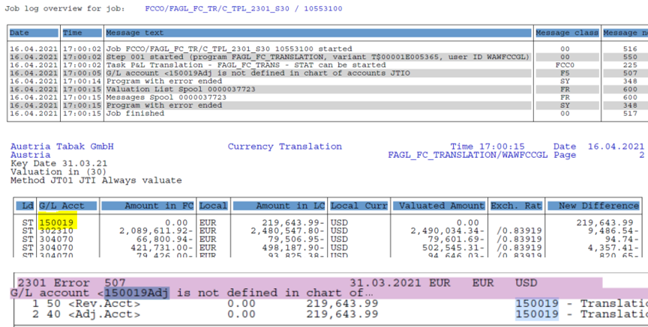
Currency Translation - Common Errors
Errors | Error Description (Reason) | Resolution
Enter rate type M in the system settings | This error occurs when ML Documents posted with Exchange Rate logic enhancement. | GL Team to Inform Market Team and raise IT ticket if needed. Workaround: During SM35 batch processing GL Team needs to update Transaction currency to Company Code Currency
GL Account XXX is not defined in chart of accounts JTIO | This error occurs when B/S Account is included in P&L Translation. | GL Team to check if account has correct ERDK. If not, GL Team to contact R2R Competency Center to submit a Change Request for the change of ERDK. P&L Accounts subject to Translation are assigned with ERDK range 6000-7999. Balance Sheet accounts subject to Translation are assigned with ERDK range 8000-9999.

Slide 14
Demonstration & exercises
Exercise No. 5: Perform Currency Translation using T-Code FAGL_FC_TRANS

